Slide 1
Brain Tumor Detection Using ML.

Slide 2
INTRODUCTION
A brain tumor is an abnormal growth of cells around the brain.
The mortality rate among brain tumor patients is 76%.
Worldwide, an estimated 308,102 people were diagnosed with a primary brain or spinal cord tumor in 2020.
Source - Brain Tumor: Statistics | Cancer.Net

Slide 3
PROBLEM STATEMENT
Detection of tumor.
Reducing the pressure of human judgement.
A major challenge for brain tumor detection arises from the variations in tumor location, shape, and size.

Slide 4
ABSTRACT
Recently, deep learning technique showed promising result towards improving accuracy of brain tumor from magnetic resonance imaging (MRI).
In this project we propose a deep learning model for the classification of brain tumor from MRI image using convolutional neural network (CNN) .

Slide 5
About Dataset
The dataset contains 3 folders : with tumor , no tumor and pred which contains 3060 MRI images.
FOLDER | DESCRIPTION
No tumor | This folder contains 1500 brain MRI images which are non-tumorous.
With tumor | This folder contains 1500 brain MRI images which are tumorous.
Source - Br35H :: Brain Tumor Detection 2020 | Kaggle

Slide 6
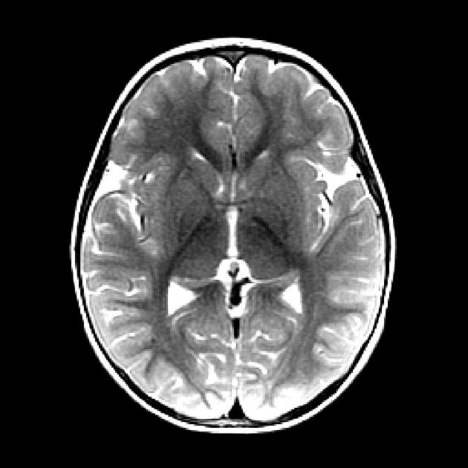
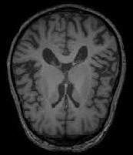
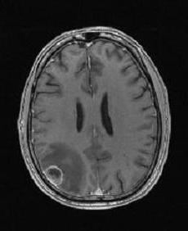
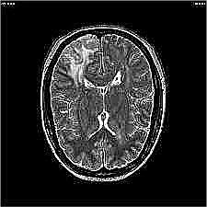
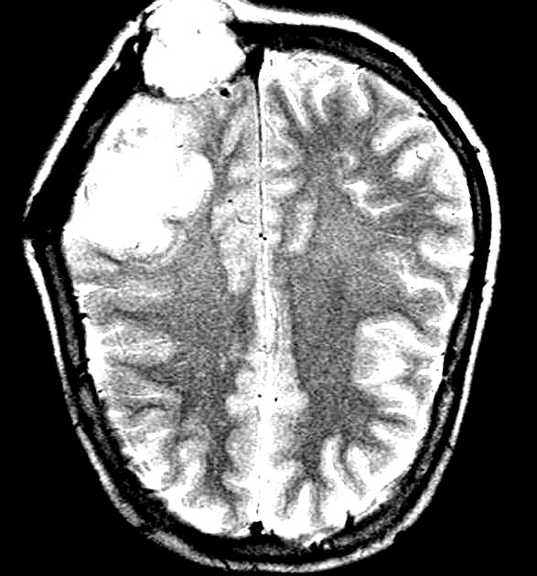
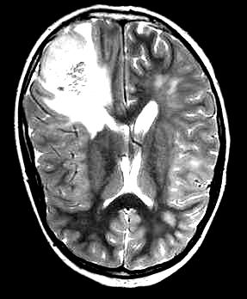
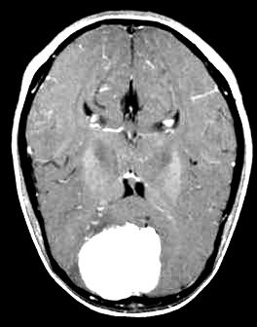
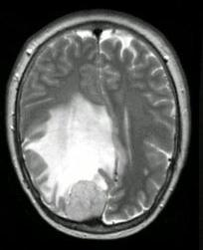
Some Images from the Dataset
No tumor (1500 images)
Source - Br35H :: Brain Tumor Detection 2020 | Kaggle
With tumor (1500 images)

Slide 7
Literature review
Elsevier - MRI based brain tumor image detection using CNN based deep learning method.
Source - MRI-based brain tumour image detection using CNN based deep learning method - ScienceDirect
Iop Science - Convolutional neural network for brain tumor detection.
Source - Convolutional Neural Network for Brain Tumor Detection - IOPscience
Springer - Detection of brain tumor using deep learning.
Source - Detection of Brain Tumour Using Deep Learning | SpringerLink
Springer - Brain tumor detection using MRI image analysis.
Source - Brain Tumor Detection Using MRI Image Analysis | SpringerLink

Slide 8
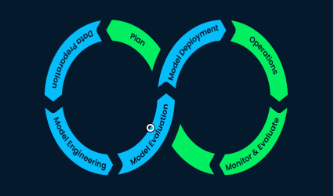
Project Development Life Cycle
Problem understanding (aka business understanding).
Data collection.
Model development, training and evaluation.
Model deployment and maintenance in the production environment.

Slide 9









Technologies Used
Python
Keras
NumPy
Jupyter Notebook
Scikit Learn
Matplotlib
TensorFlow
Pandas
OpenCV

Slide 10
Proposed Methodology
Split the data into train, validation and test sets
Splitting data in two parts training and testing
Image pre-processing
To avoid the extra computational calculations.
2nd
4th
1st
3rd
Normalize the image
For putting the image in same statistical distribution in terms of size and pixel
Building the model
CNN model

Slide 11
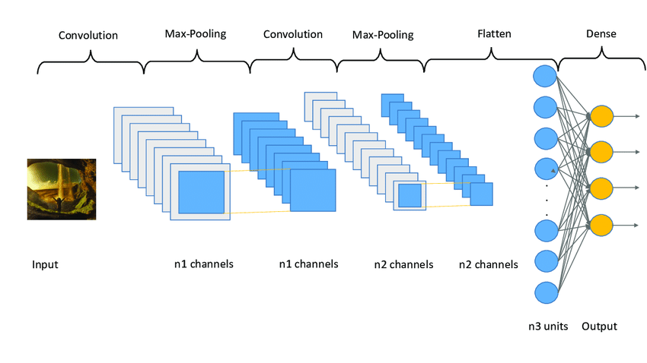
Working of Convolutional Neural Network

Slide 12
CONCLUSION
MRI is most vastly used for tumor segmentation and classification.
Our CNN based model will help the doctor to detect brain tumor through MRI images.
Increases accuracy in detection.
Speed of treatment will increase.

Slide 13

Thanks!
Presented by
Ayush Sonwane
Himank Patel
Anvesha Raikwar
Bhagyashree Rajput

